Slide 1
Java Review Slides
Dave Slemon, v100

Slide 2
Q1. Static Class Constants
Create a class called, Me.
Declare and populate a static class constant called, NUM_FAMILY_MEMBERS and set it to 6;

Slide 3
A1. Static Class Constants
Create a class called, Me.
Declare and populate a static class constant called, NUM_FAMILY_MEMBERS = 6

Slide 4
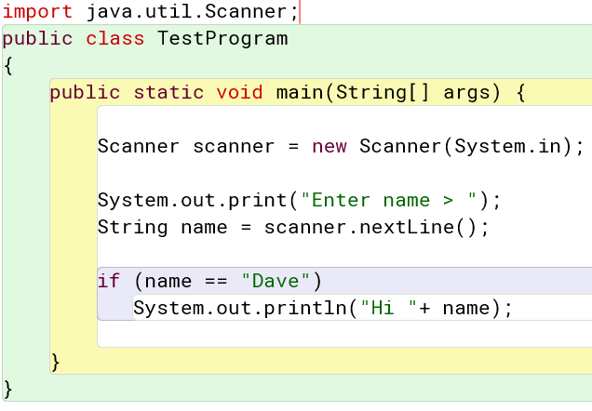
Q2. Rewrite this code so that it works as intended

Slide 5
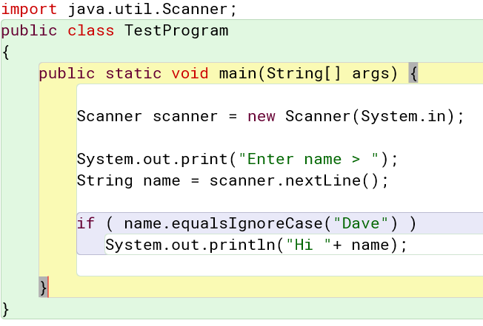
A2. Rewrite this code so that it works as intended

Slide 6
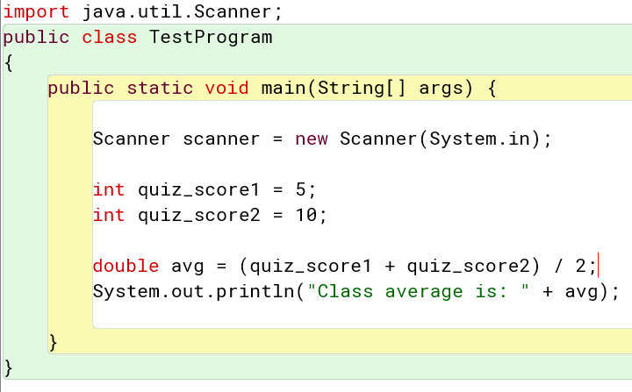
Q3. Rewrite this code so that it works as intended

Slide 7
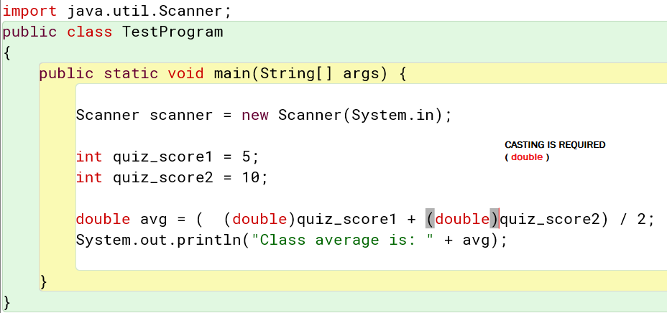
A3. Rewrite this code so that it works as intended

Slide 8
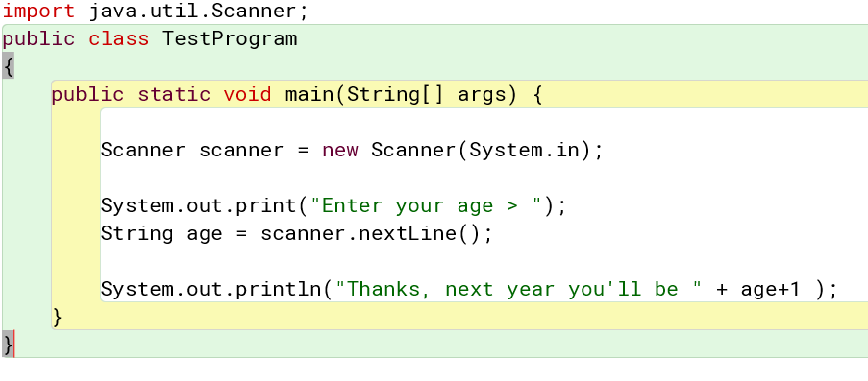
Q4. Rewrite this code so that it works as intended

Slide 9
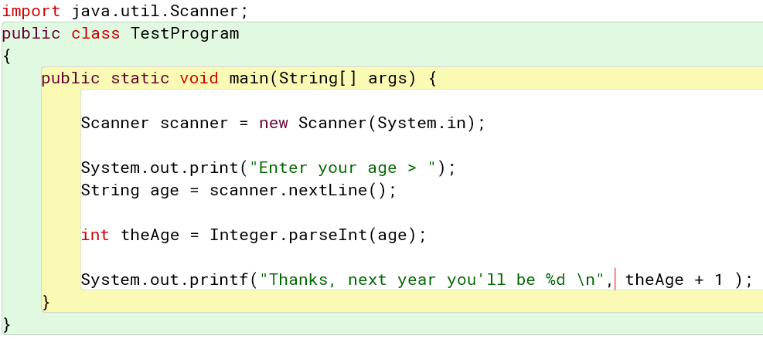
A4. Rewrite this code so that it works as intended

Slide 10
Q5. In a method, how would you declare a constant called,
MAX = 100;

Slide 11
A5. In a method, how would you declare a constant called,
MAX = 100;
static final int MAX = 100;
The reason that we have to use both static and final modifiers is that if we declare a variable ‘var’ only as static, all the objects of the same class will be able to access this ‘var’ and change its values. When we declare a variable only as final, then multiple instances of the same constant value will be created for every different object and that isn’t efficient/desirable. When we use both static and final, then, the ‘var’ remains static and can be initialized only once, thereby making it a proper constant which has a common memory location for all objects of it’s containing class.

Slide 12
Q6. Consider TestProgram.java. Add some code to TestProgram.
Declare a variable to Car. The constructor allows for one colour and the make of the car. e.g. Red Toyota. Output the variable object to the terminal window.

Slide 13
A6. Consider TestProgram.java. Add some code to TestProgram. Declare a variable to Car. The constructor allows for one colour and the make of the car. e.g. Red Toyota. Output the variable object to the terminal window.
Car t = new Car( Color.RED, “Toyata” );
System.out.println( t );

Slide 14
Q6. Ask a teenager to enter his or her age. Continue to ask the teenager for their age until they enter an age between 13 and 19 inclusive.
You can assume that the user always enters a GOOD integer.
Your program
should output as shown in the sample session below:
Enter your age (13-19) > 20 Enter your age (13-19) > 12 Enter your age (13-19) > 24 Enter your age (13-19) > 14 Thank you, you are 14 years old

Slide 15
import java.util.Scanner;
public class question9
{
public static void main(String[] args){
Scanner scanner = new Scanner(System.in);
int age = 0;
do{
System.out.print("Enter your age (13-19) > ");
age = scanner.nextInt();
scanner.nextLine(); //clear the line
} while(age < 13 || age > 19);
System.out.print("Thank you, you are " + age + " years old");
}
}
A6. Ask a teenager to enter his or her age.
Continue to ask the teenager for their age until
they enter an age between 13 and 19 inclusive.
You can assume that the user always enters a
GOOD integer.
Your program should output as shown in the
sample session below:
Enter your age (13-19) > 20 Enter your age (13-19) > 12 Enter your age (13-19) > 24 Enter your age (13-19) > 14 Thank you, you are 14 years old

